Slide 1
HTTP Client
Lesson08
Notes:
Add instructor notes here.

Slide 2
Lesson Objectives
The HTTP providers
Injecting the providers
GET call
Handling error
About Observables
POST request
Working with headers
Notes:
Add instructor notes here.

Slide 3

HTTP
Angular applications often obtain data using http
Application issues http get requests to a web server which returns http response-Observable to the application.
Application then processes that data

Slide 4
Observables
Observables is a part of ReactiveX library also known as rxjs
import { Observable } from 'rxjs/Observable';
Observables is like an array whose items arrived asynchronously. The role of ReactiveX to provide asynchronously programming
Observable help to manage asynchronous data, such as data coming from a backend service. That data we are going to subscribe
Observable work with multiple value
Observable are cancellable
Observable use javaScript function such as map filter & reduce
Notes:
Data sequences can take many forms such as a stream of data from a backend web service or a set of system notifications or a series of events such as user input.
Reactive extensions represent a data sequence as an observable sequence commonly just called an observable.
A method can be subscribed to an observable to receive asynchronous notifications as new data arrives. The method can then react with the arrived data. The method is notified when there is no more data or one an error occurs. Since an observable works like an array we can use the map operator.
We can visualizing observable sequences with interactive diagrams from http://rxmarbles.com/
Add instructor notes here.
Marble diagram

Slide 5
Introducing RxJs
RxJs stands for Reactive Extensions for Javascript, and its an implementation of Observables for Javascript.
It is a ReactiveX library for JavaScript.
It provides an API for asynchronous programming with observable streams.
ReactiveX is a combination of the best ideas from the Observer pattern, the Iterator pattern, and functional programming.
Observable is a RxJS API. Observable is a representation of any set of values over any amount of time. All angular Http methods return instance of Observable. Find some of its operators.
map: It applies a function to each value emitted by source Observable and returns finally an instance of Observable.
catch: It is called when an error is occurred. catch also returns Observable.
Notes:
The RxJS library is quite large.
It's up to us to add the operators we need
// Add map operator
https://cdnjs.cloudflare.com/ajax/libs/rxjs/4.1.0/rx.map
// Add all operators to Observable https://cdnjs.cloudflare.com/ajax/libs/rxjs/4.1.0/rx.all.js
// Add map operator
import 'rxjs/add/operator/map';
// Add all operators to Observable import 'rxjs/Rx';
Add instructor notes here.

Slide 6
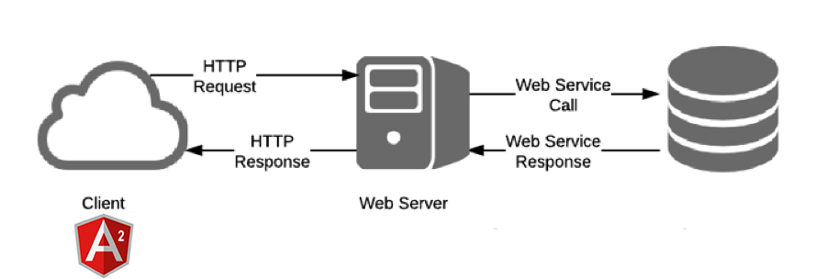
Angular2 HTTP
The HttpModule is not a core Angular module. HttpModule is Angular's optional approach to web access. It exists as a separate add-on module called @angular/http and is shipped in a separate script file as part of the Angular npm package.
We need to import from @angular/http because systemjs.config configured SystemJS to load that library when you need it.
From Angular client we request from web server & we get the data back from in response
To allow access to these services from anywhere in the app, add HttpModule to the imports list of the AppModule.
Notes:
Add instructor notes here.

Slide 7
Angular2 HTTP-Services.ts
The HttpModule from the @angular/http library holds providers for a complete set of HTTP services.
The Angular http.get returns an RxJS Observable. Observables are a powerful way to manage asynchronous data flows
The response JSON has a single data property, which holds the array of employee that the caller wants.
If we want to read any json file instead of http.get(“employee.json").
Map is imported from rxjs/add/operator/map
For handling error we use catch imported from "rxjs/add/operator/catch"
getAllEmployee():Observable<Employee[]>
{ return this.http.get("http://localhost:9090/SpringWithAngular/rest/employee") map((response:Response)=><Employee[]>response.json())
.catch(this.handleError);
Notes:
So basically, map() allows you to perform some kind of action on the values inside a container. And the same thing is true with the then() method in a promise. You can call then() on a promise to call some function on the value inside of a promise. And then that returns a new promise with whatever new value you created..

Slide 8
Angular2 HTTP-Component.ts
Angular component requesting service to get employee data,get the JSON data back from service
Include your Service ---providers:[EmployeeService]
Import---- import {EmployeeService} from './employee.service'
this.empservice.getAllEmployee().subscribe((employeeData)=>this.employees=employeeData,
(error)=>{
this.statusmessage="Problem with service check server"
// console.error(error);
}
);
Notes:
the subscribe() method as if we were calling then() on a promise that was returned, or if you think about this as an array, subscribe() is like the forEach() method on an array. It's kind of like map() in that it receives whatever is inside of the array, or in this case the observable.

Slide 9
Demo
DemoHttpGet
DemoHttpDelete
DemoHttpGetErrorHanding
Notes:
Add the notes here.
Add instructor notes here.

Slide 10
Lab
Lab 4.1
Notes:
Add the notes here.
Add instructor notes here.

Slide 11
Summary
Observables is like an array whose items arrived asynchronously.
Observable help to manage asynchronous data, such as data coming from a backend service.
Observables are proposed feature for ES 2016 the next version of JavaScript. To use observables now angular uses a third party library called reactive extensions.
Angular applications often obtain data using http
Application issues http get requests to a web server which returns http response to the application.
Application then processes that data
Notes:
Add instructor notes here.

